Slide 1
Click & Cart

Slide 2
Scenario
An online fashion boutique needs a database to manage:
Operations
Product Information
Customers orders
Inventory
Employee Information

Slide 3
Identifying The Tables
Customers Table
Orders
Order Details
Inventory Table
Product Tables
Employees

Slide 4
Defining The Purpose Of Each Table
Products Table:
The Products table is designed to store detailed information about each item available for sale at Click and Cart. It includes a unique identifier for each product, a descriptive name, a detailed description, the selling price, and the category or type of the product, such as dresses or shoes.
Customers Table:
The Customers table holds information about the individuals who make purchases from Click and Cart. It contains a unique identifier for each customer, their first and last names, email address, phone number, and details about their shipping addresses and preferred payment methods.
Employees Table:
The Employee table hold information about the employees including the employee ID connecting to the order details so we know which employee processed the order.

Slide 5
Orders Table:
The Orders table records the details of each order placed by customers. It includes a unique order number, a reference to the customer who placed the order, the date the order was placed, and the total amount of the order.
Inventory Table:
The Inventory table is used to track stock levels for each product. It features a unique identifier for each inventory record, a reference to the associated product, the quantity of units available, and the date when the inventory information was last updated.
Order Details Table:
The Order Details table manages the many-to-many relationship between orders and products by detailing each product included in an order. It includes a unique identifier for each order detail record, a reference to the order, a reference to the product, the quantity of the product ordered, and the unit price at the time of the order.

Slide 6
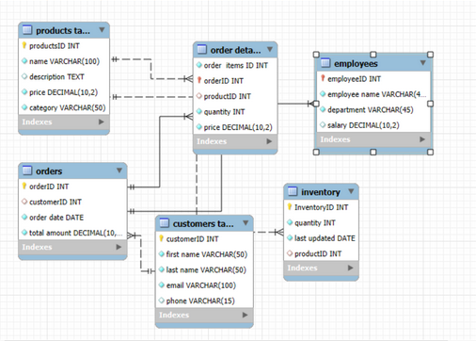
Determining The Relationship Between The Tables

Slide 7






Tables Designing

